Slide 1


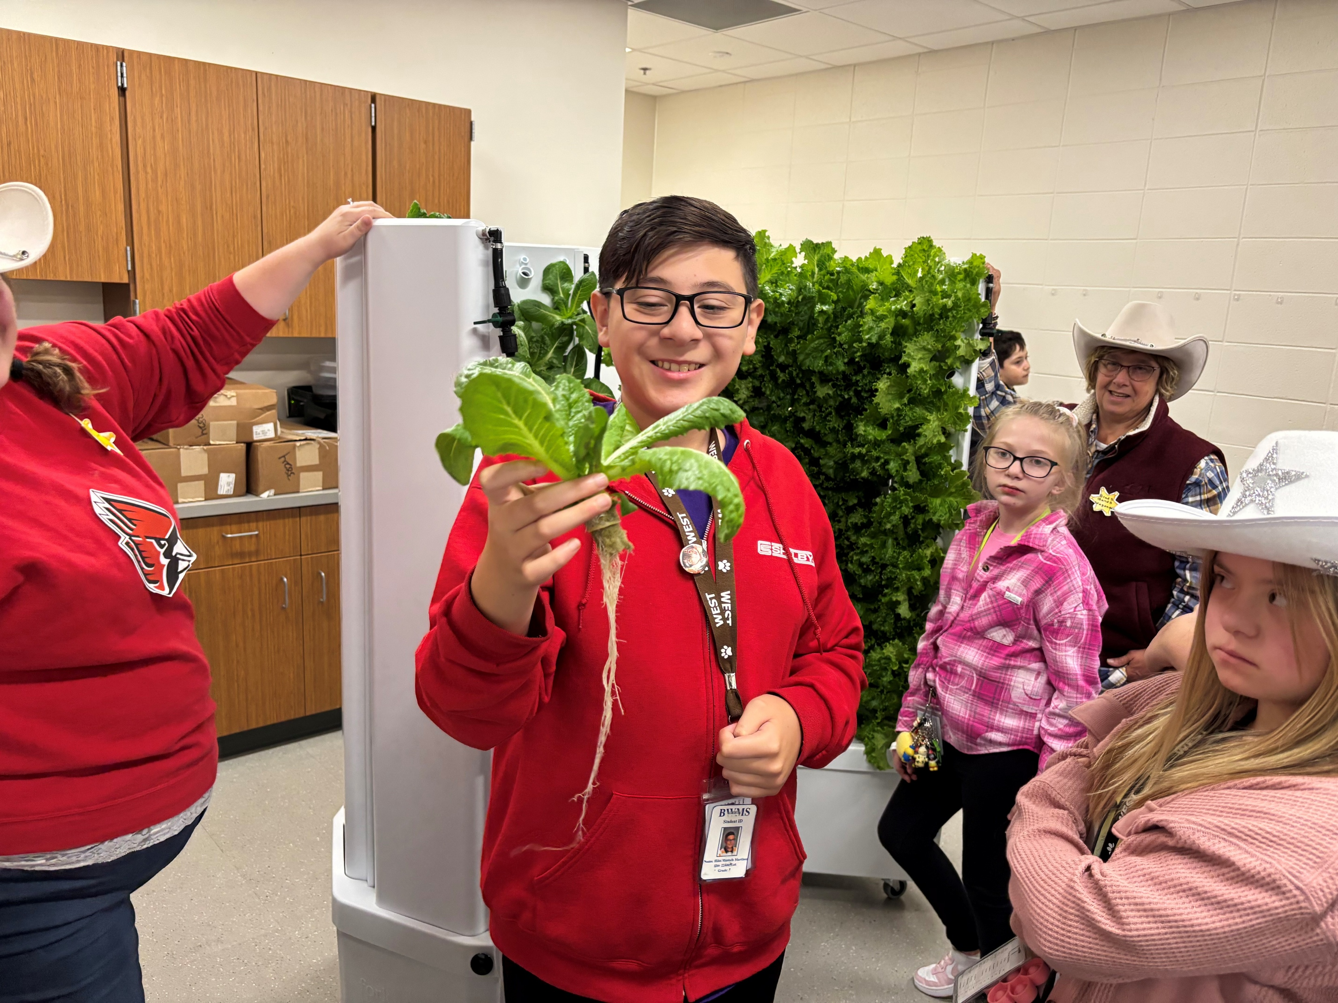
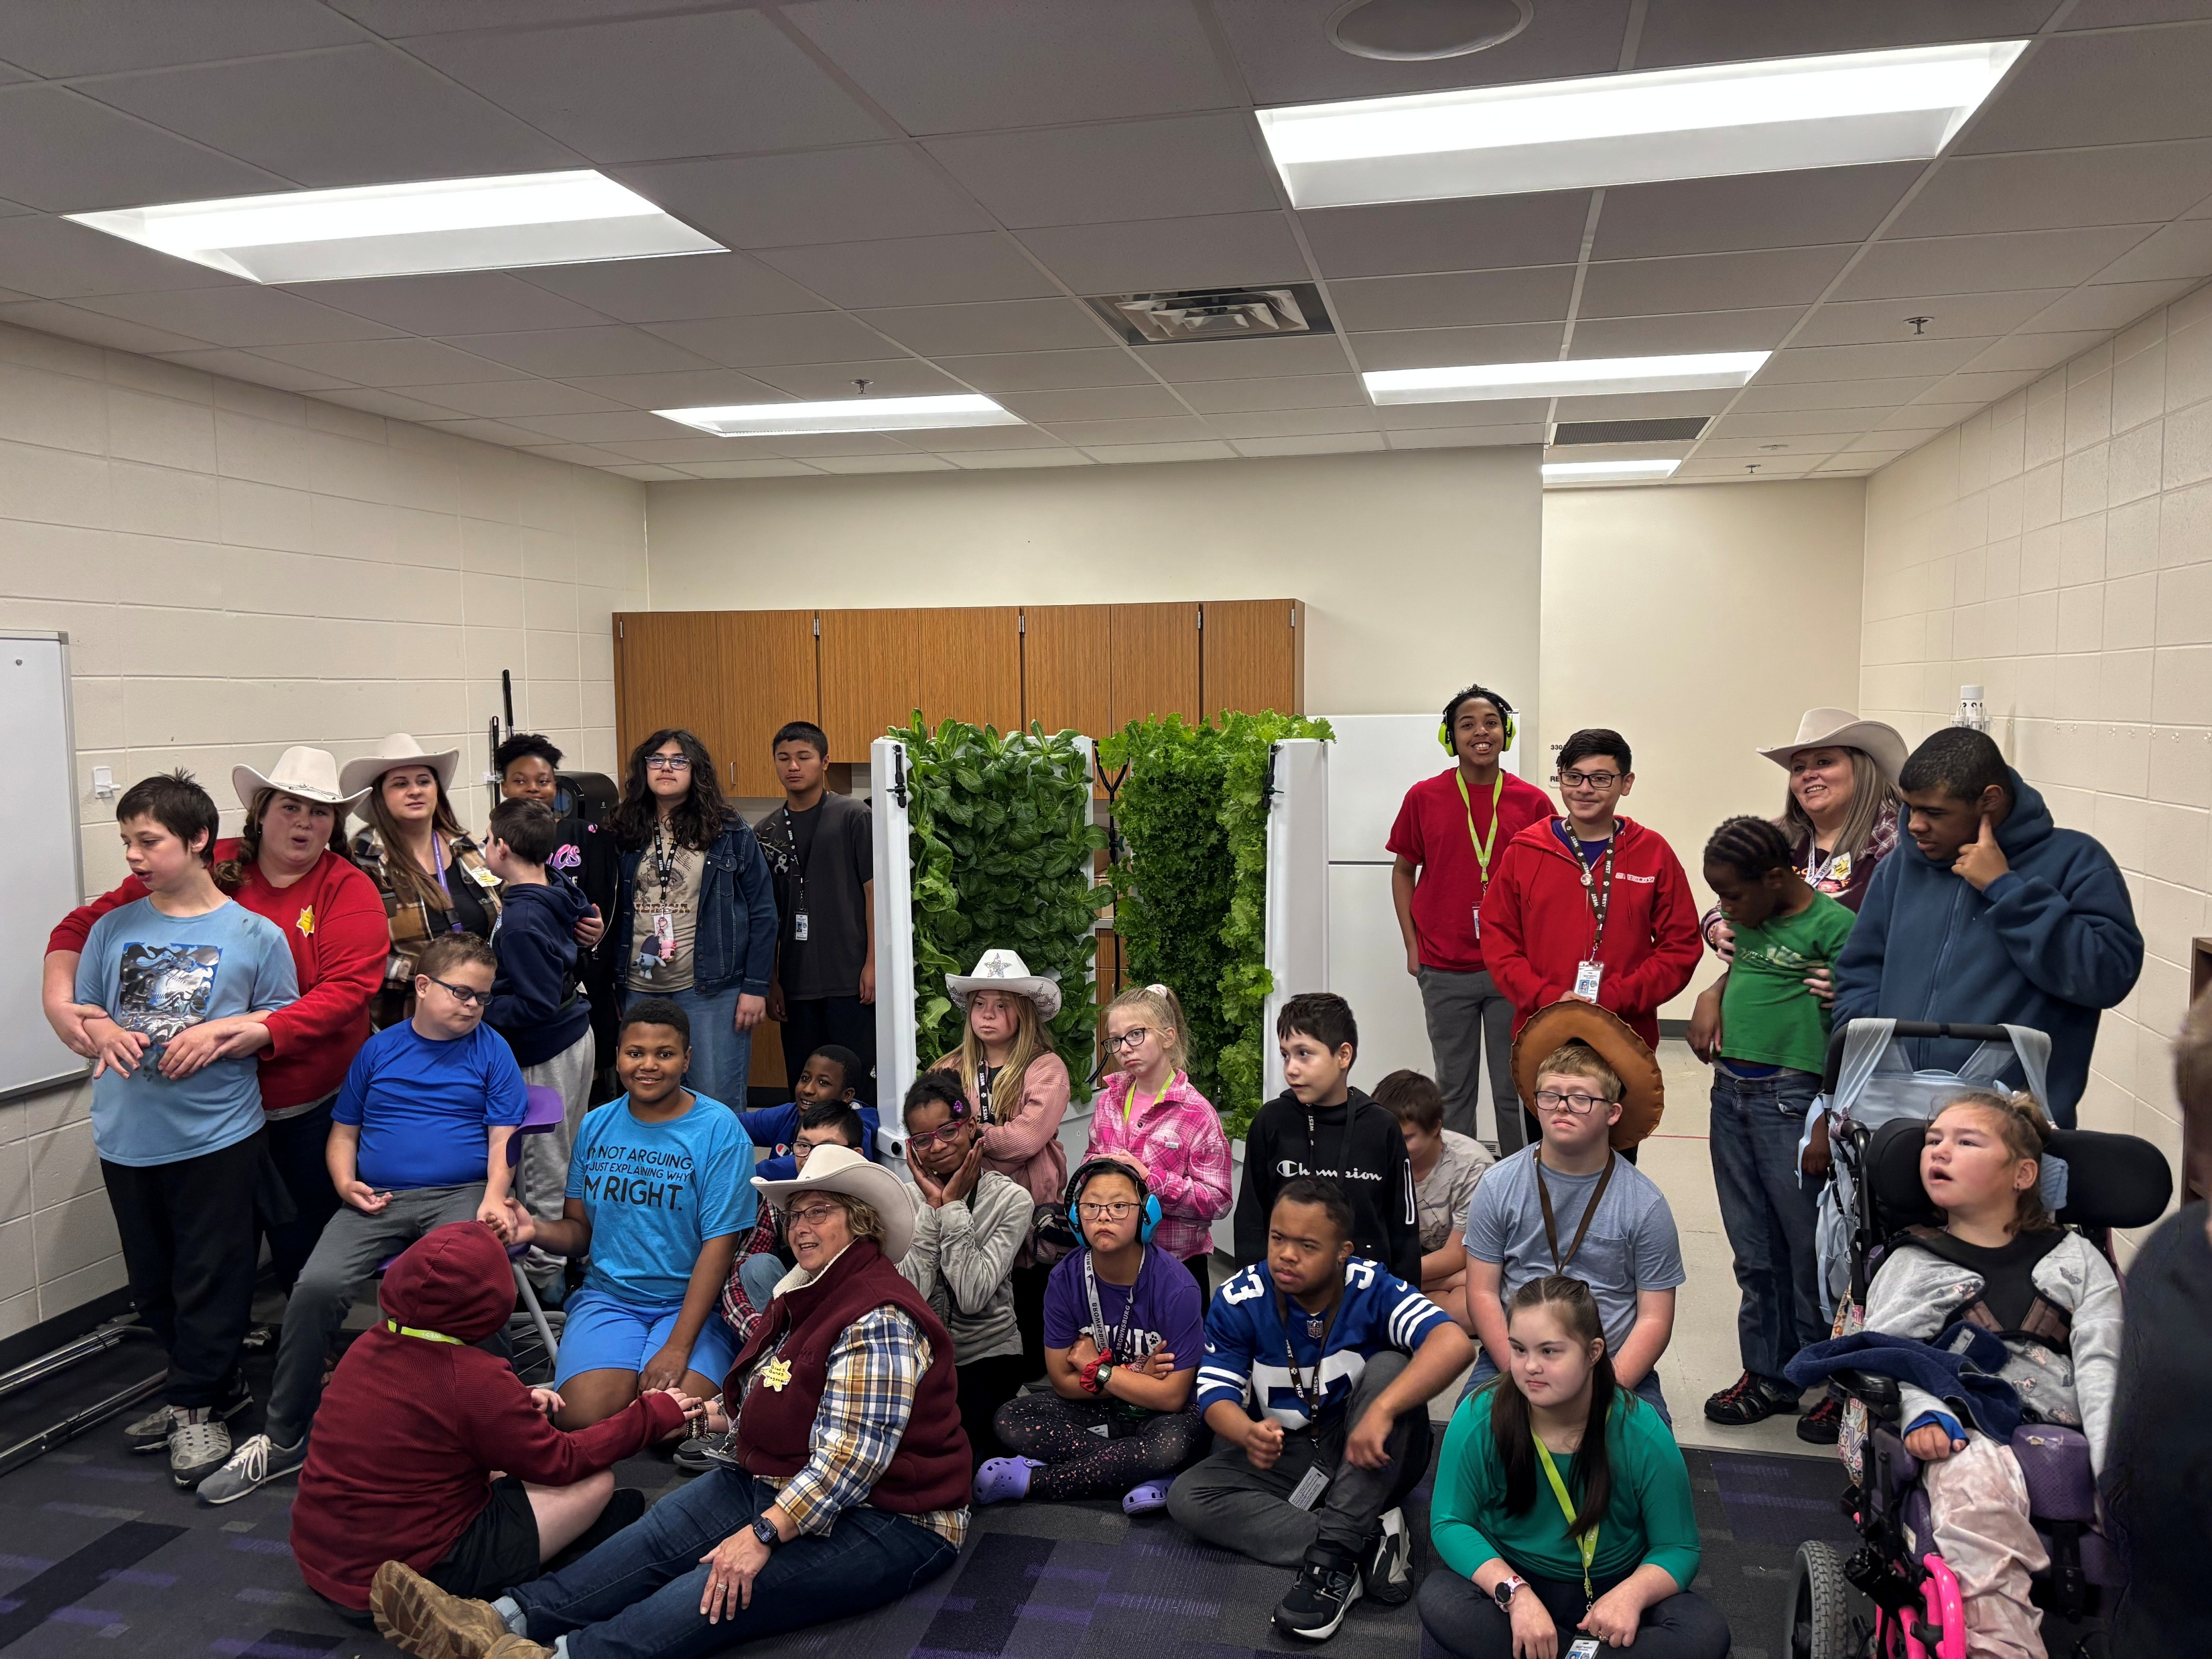
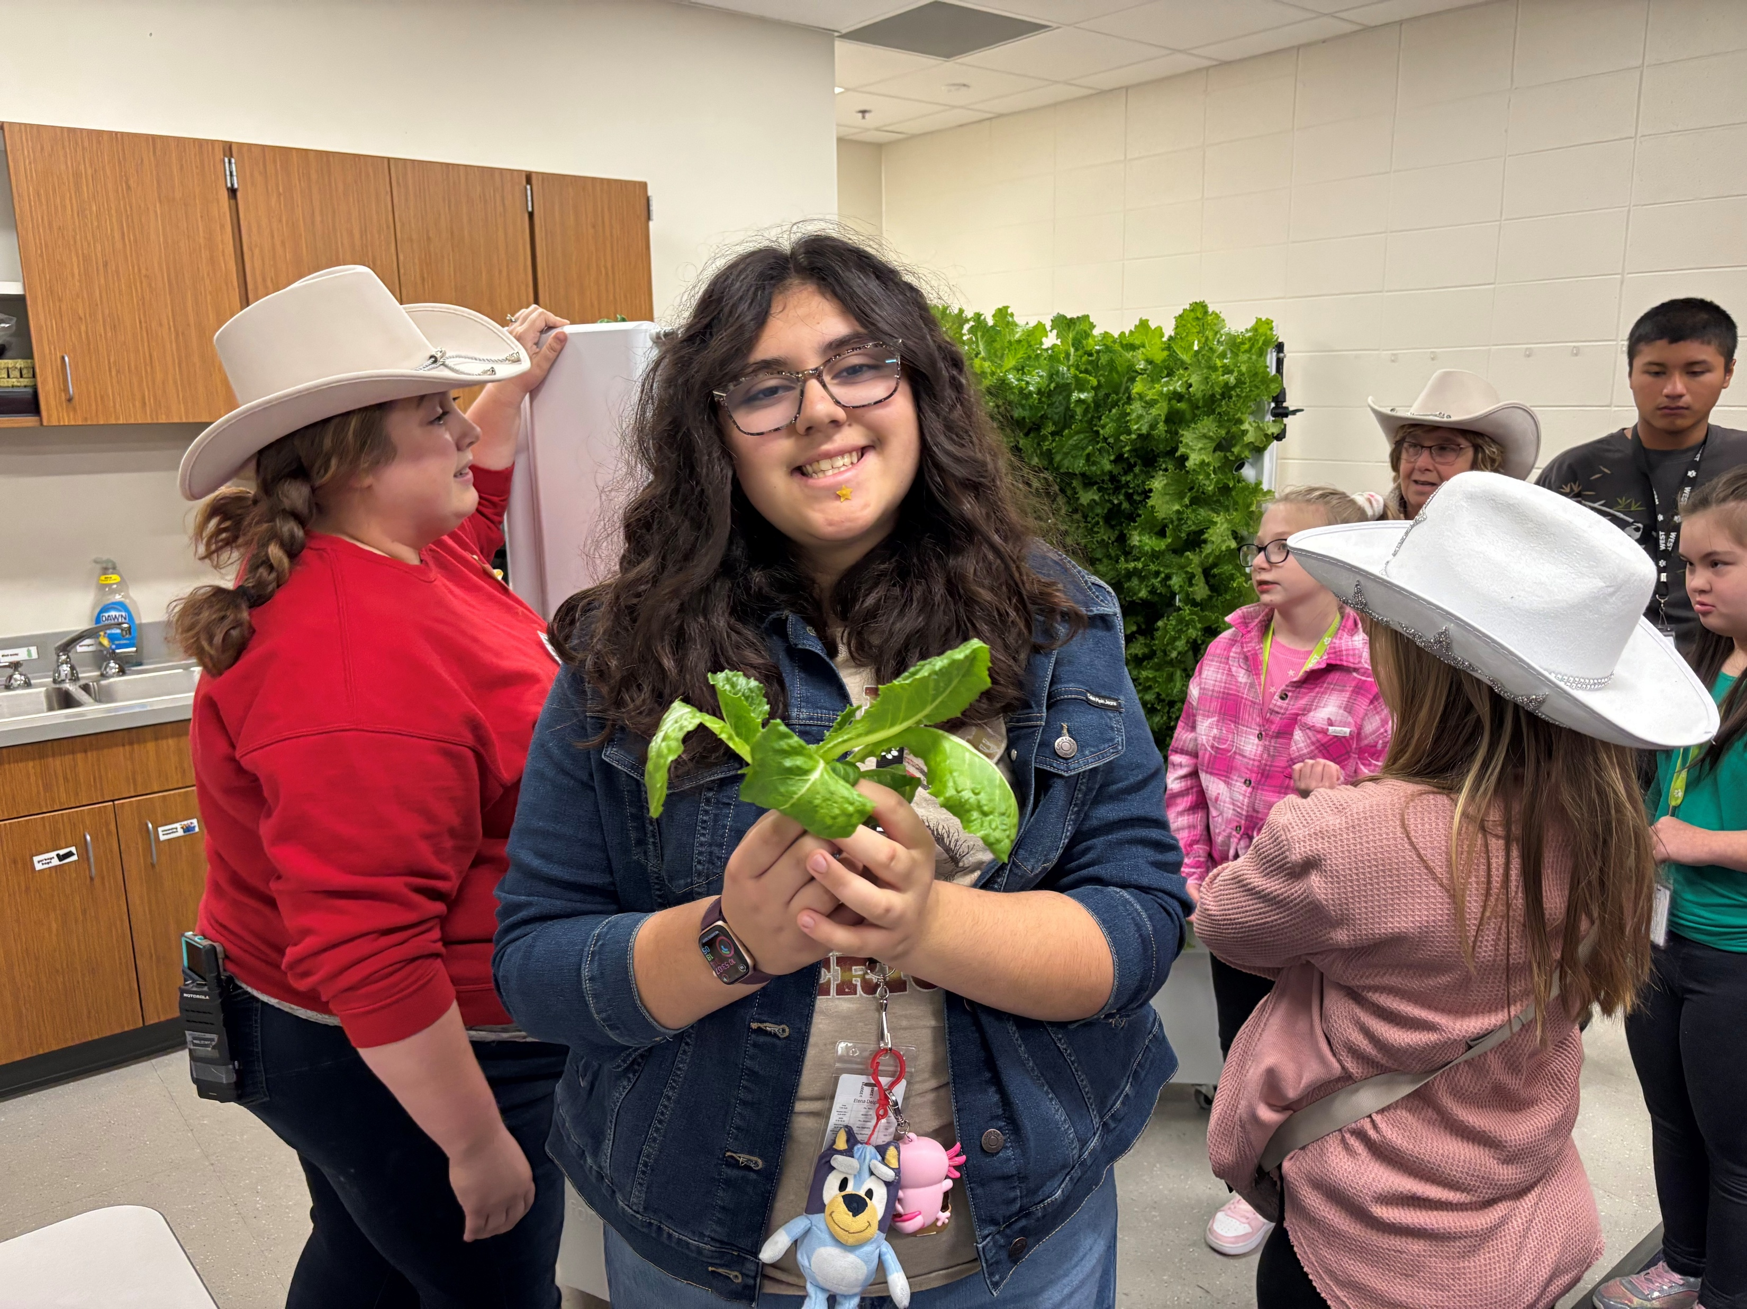
Seeds for Success
at the Brownsburg West Middle School
Sponsored in part by
This BEF InCredible Award Grant purchased a Flex Farm hydroponic growing system for the Applied Skills middle school students. Through tasks related to growing vegetables from seeds to plants, these students gain skills in responsibility, task completion, workplace readiness, and taking pride in their work. Harvested crops are bagged and donated to the Brownsburg Community Schools Food Pantry, allowing students to give back to their community.
2025

