Slide 1


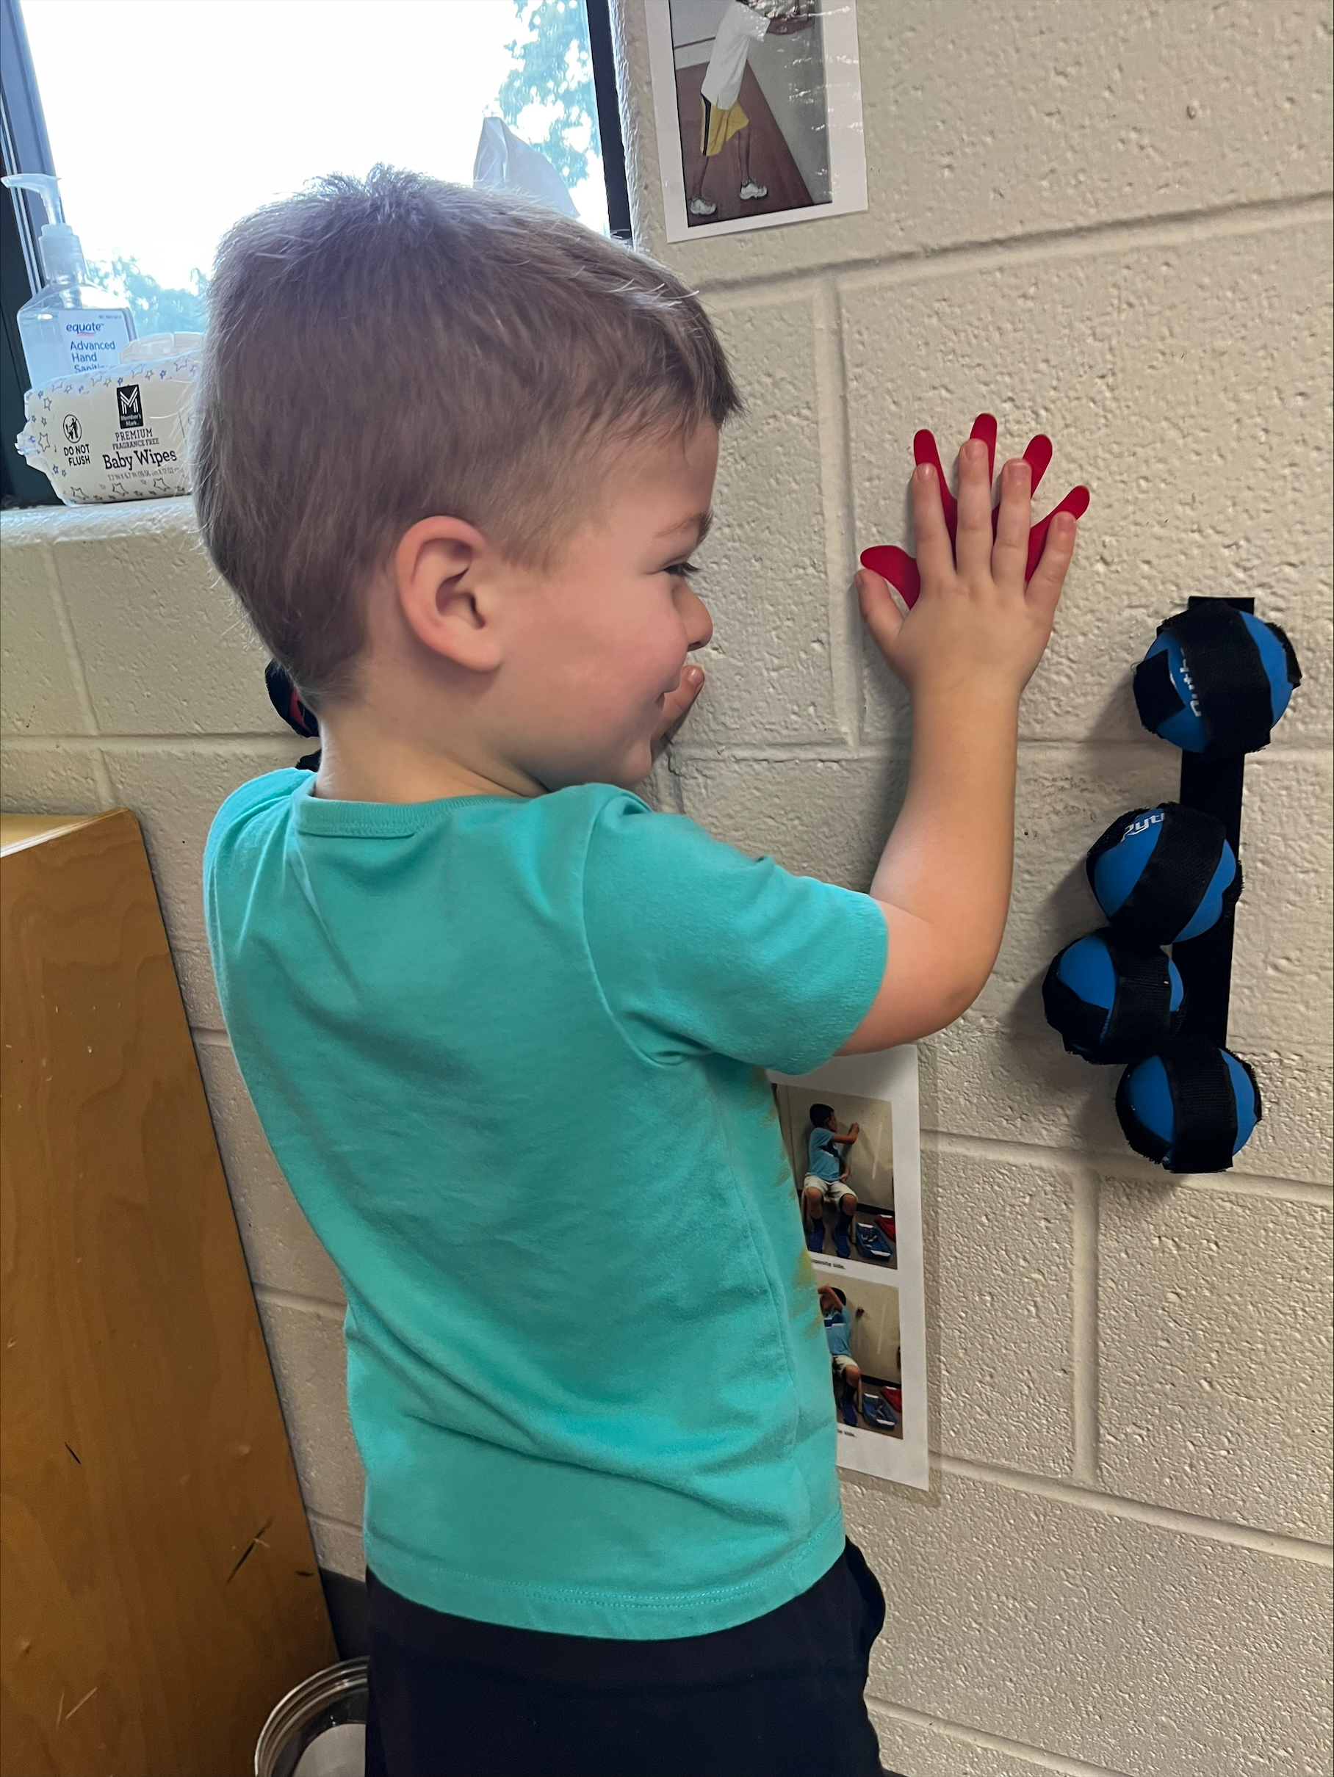
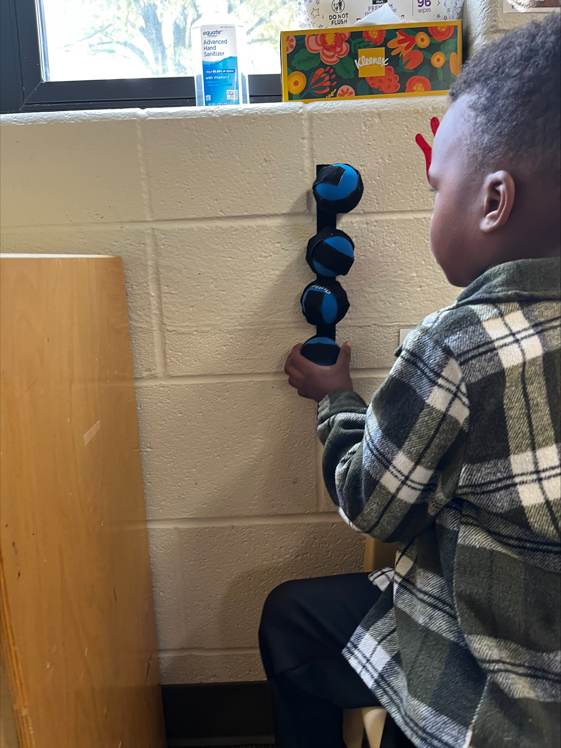
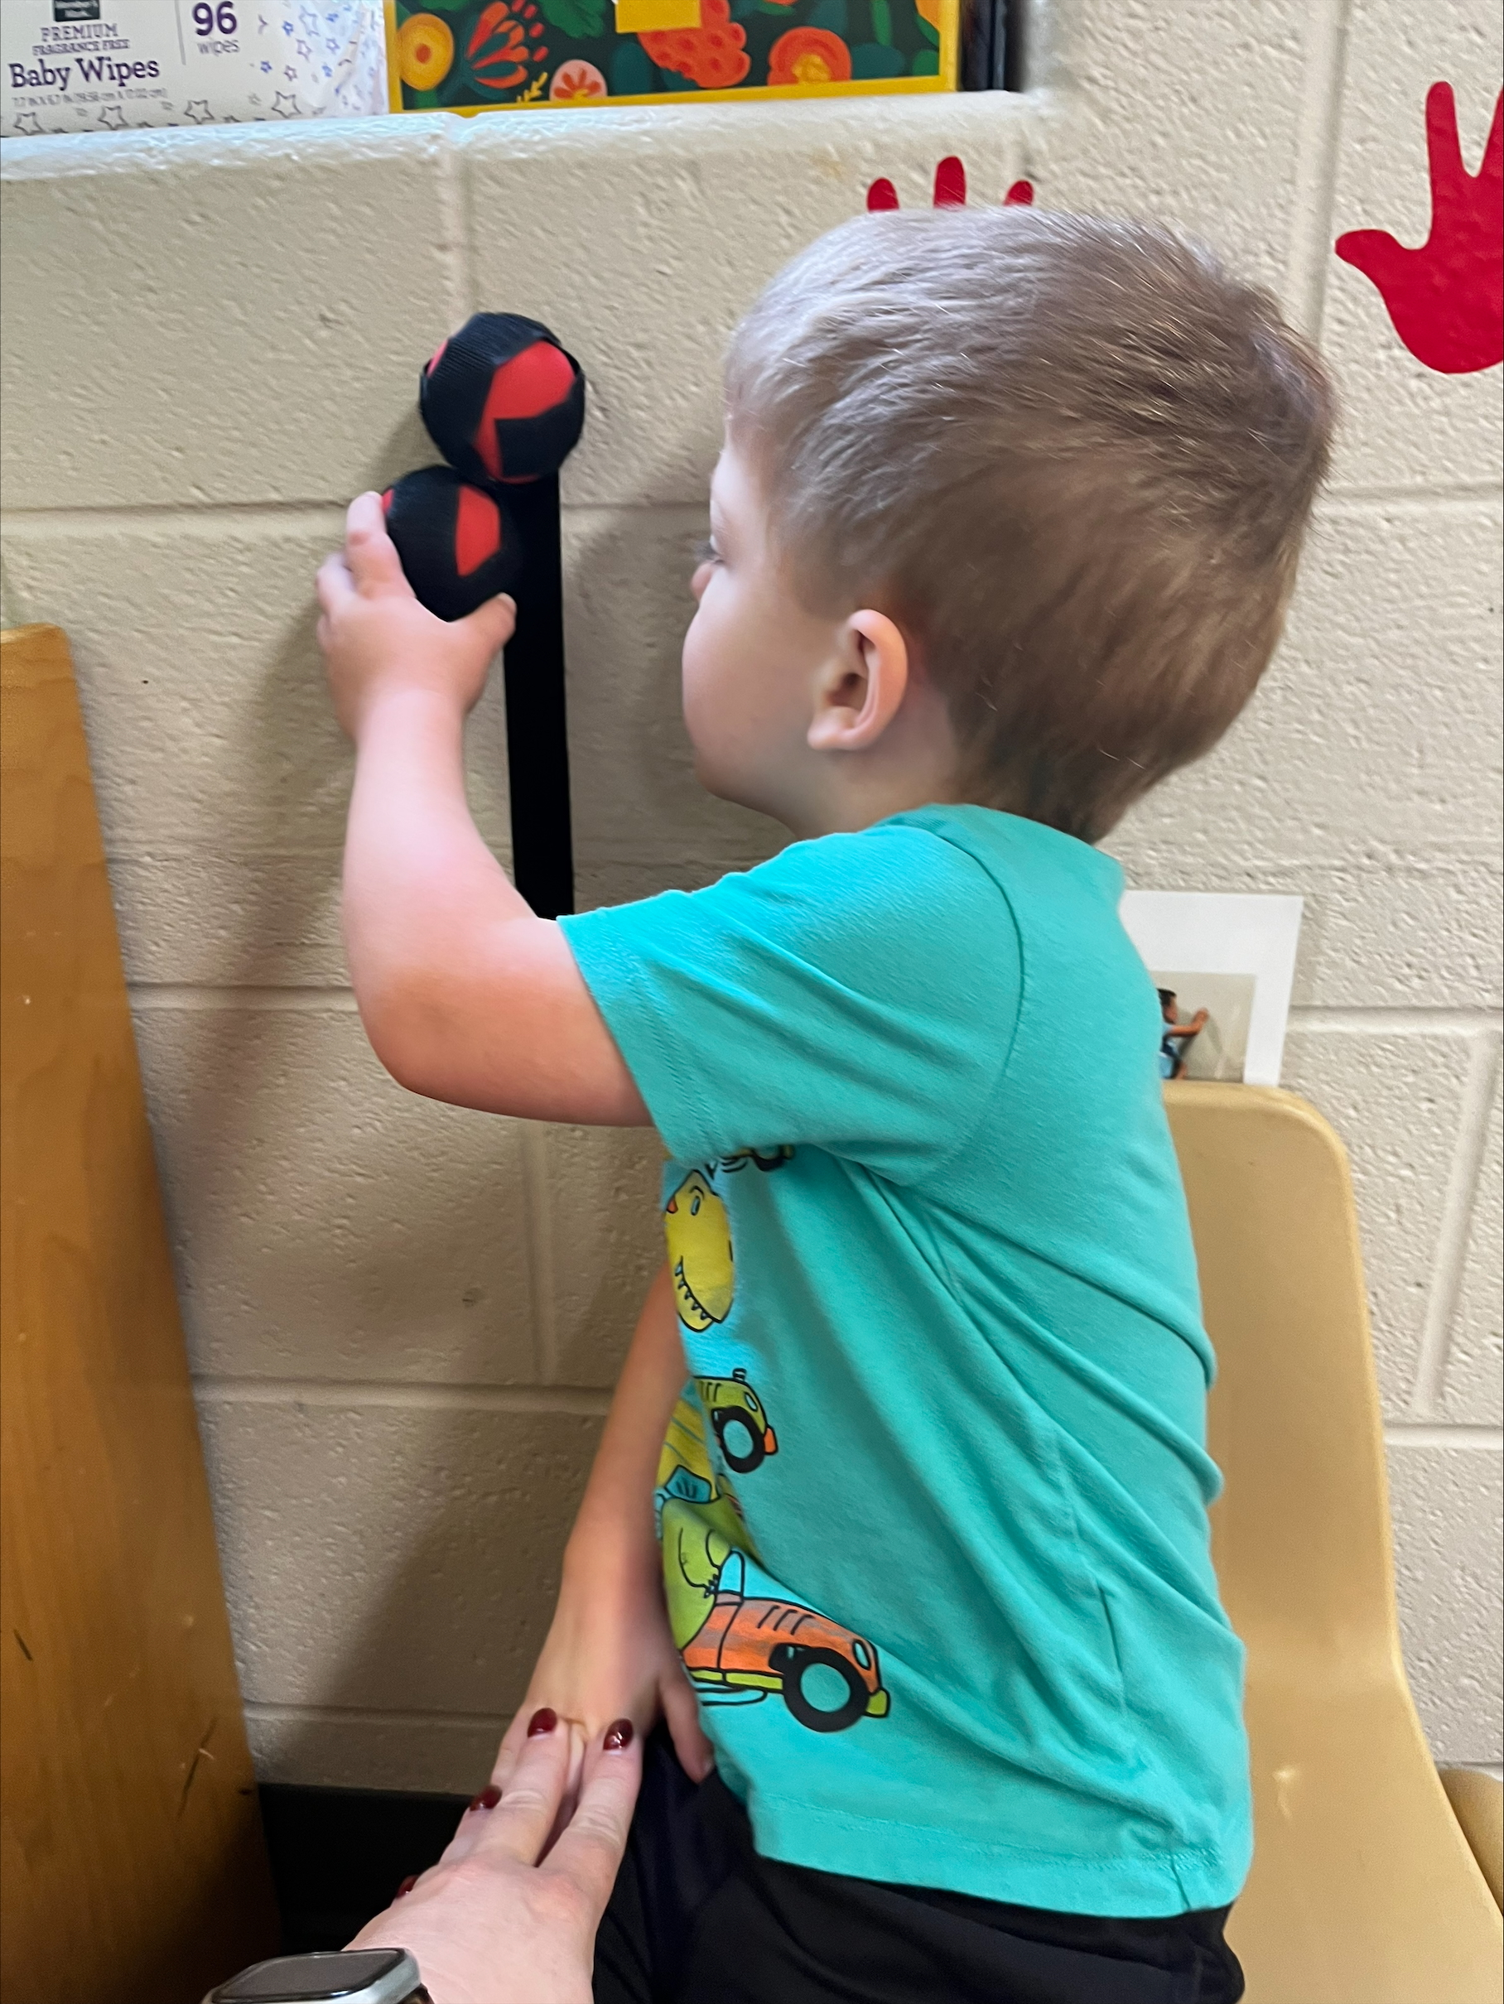
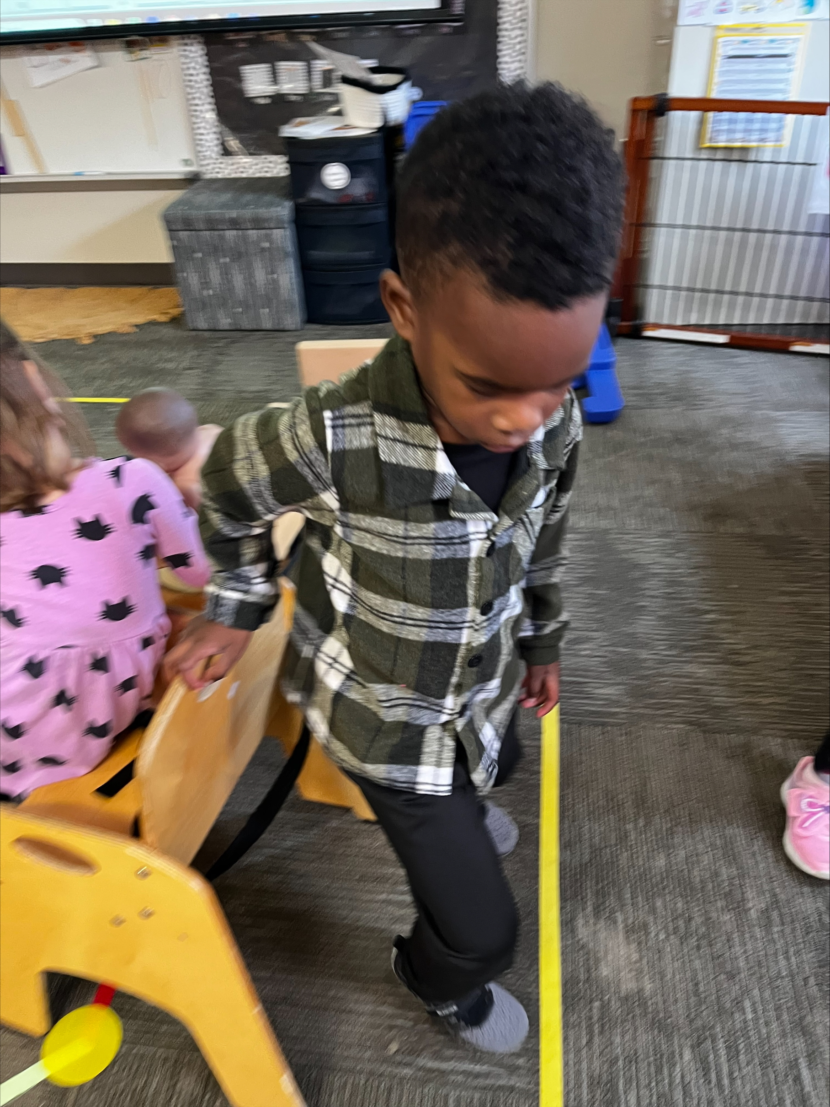
Minds in Motion in the Classroom
at the Brownsburg Early Childhood Center
Sponsored in part by
This BEF InCredible Award Grant purchased Minds in Motion pathways materials for each classroom at BECC so that these resources are easily accessible to all students who need a break to learn and practice self regulation.
2025

