Slide 1


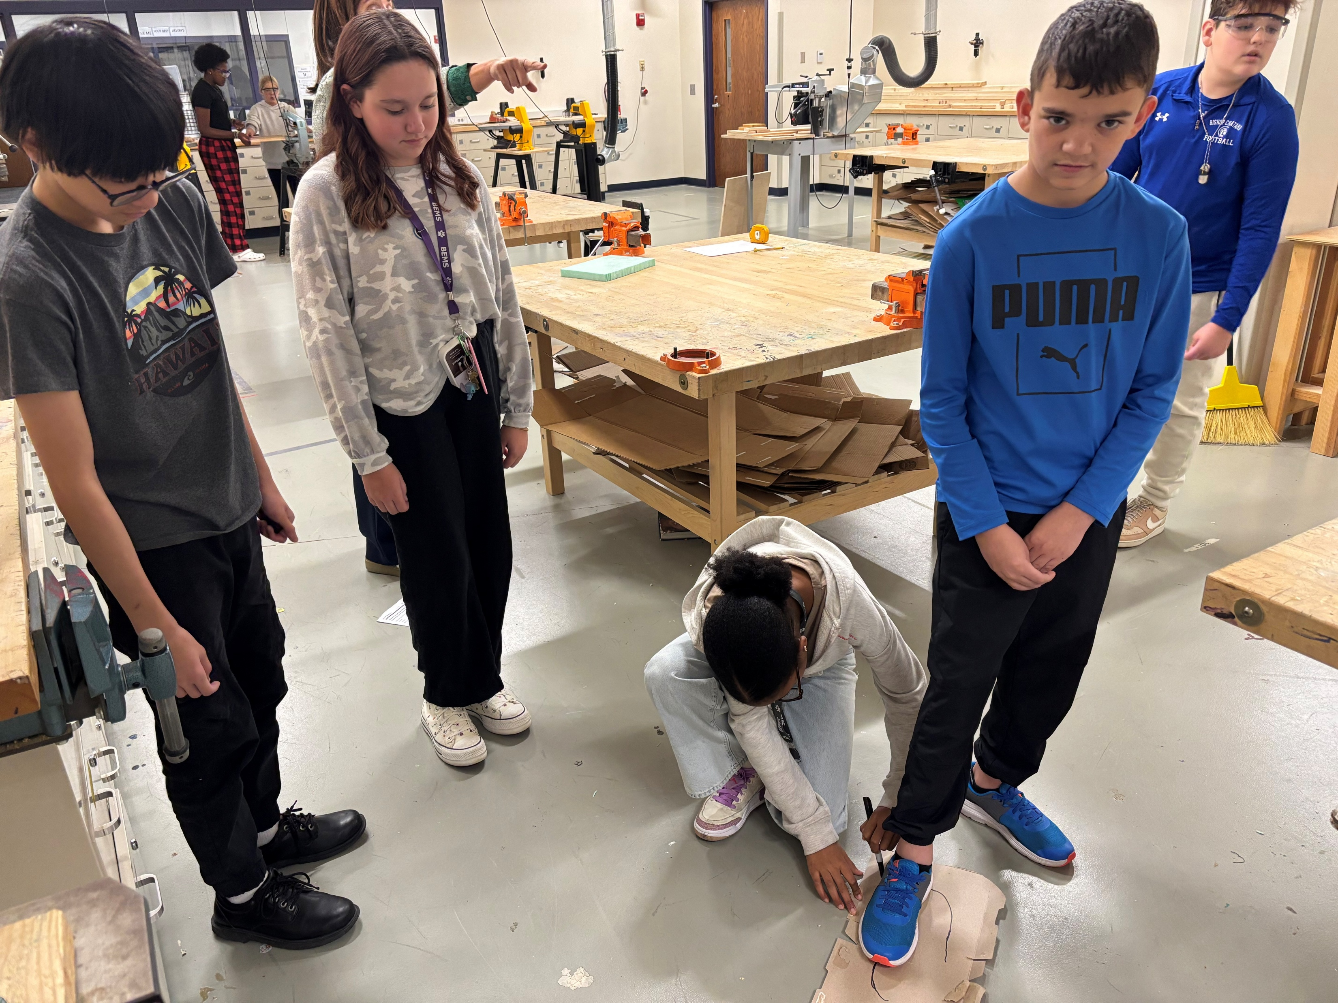
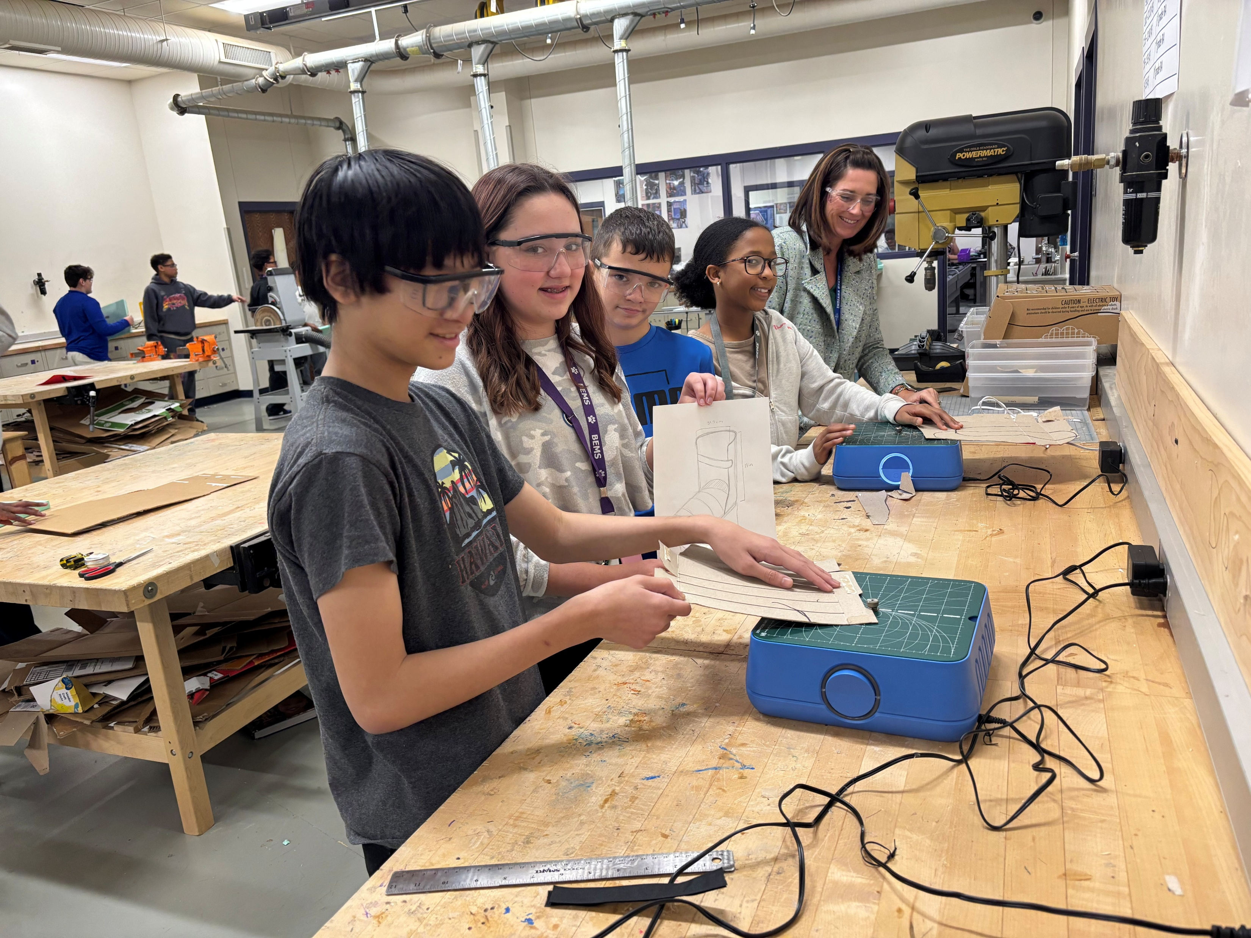
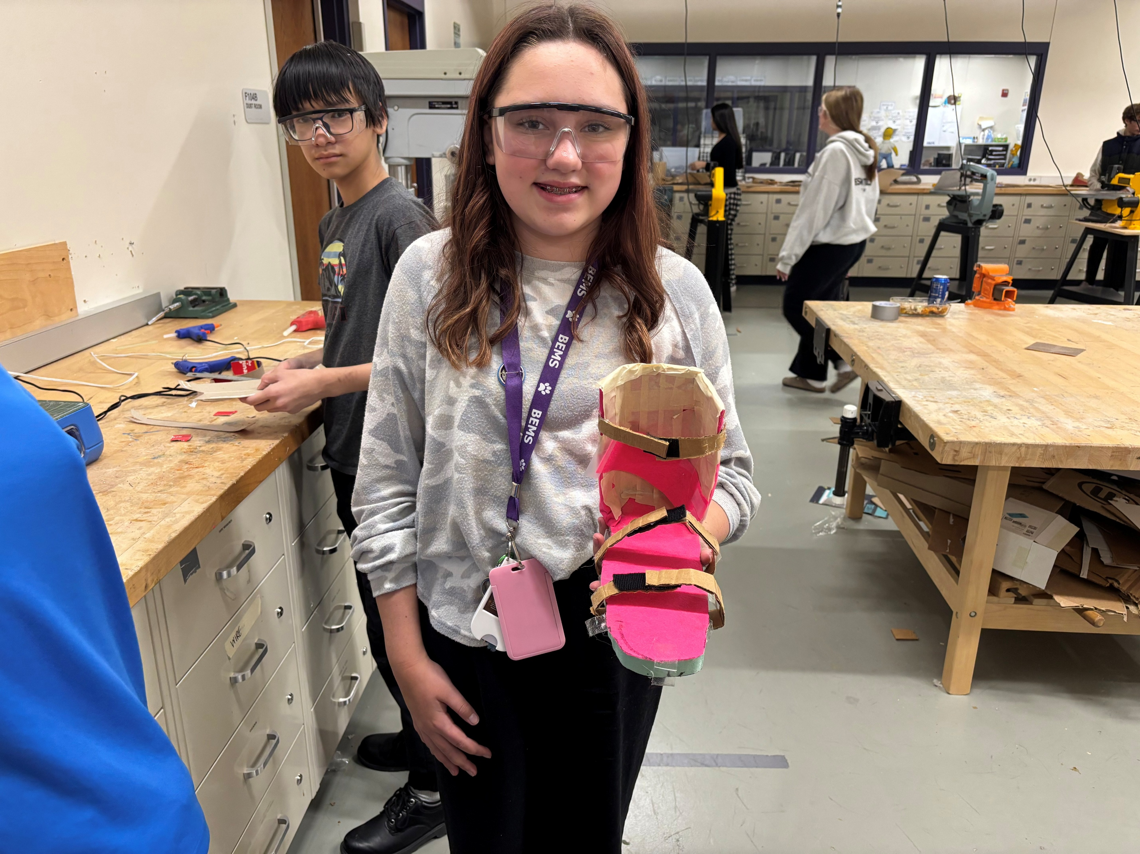
Tool for STEM Prototypes
at the Brownsburg East and West Middle Schools
Sponsored in part by
This BEF InCredible Award Grant provided chomp saws and electric foam cutters to equip middle school Gateway to Technology (GTT) students with professional-grade prototyping tools. Students research disabilities and disorders, then use the engineering design process to build working models of foot orthoses and adaptive toys that address real-world needs. The new equipment enables students to transform their technical drawings into quality prototypes, giving them hands-on experience with tools they'll encounter in STEM careers.
2025

